Slide 1
Adapter Pattern

Slide 2
Adapter Pattern
Adapter pattern works as a bridge between two incompatible interfaces
Also known as wrapper
This type of design pattern comes under structural pattern
This pattern combines the capability of two independent interfaces
This pattern involves a single class which is responsible to join functionalities of independent or incompatible interfaces

Slide 3
Adapter Pattern
Problem:
We want to reuse the capability of an existing interface that is incompatible

Slide 4
Adapter Pattern
It follows Robert C. Martin’s Dependency Inversion Principle and enables you to reuse an existing class even so it doesn’t implement an expected interface.
Dependency Inversion Principle
“high level modules should not depend on low level modules; both should depend on abstractions. Abstractions should not depend on details. Details should depend upon abstractions.”

Slide 5
Homework
How Adapter pattern ensures ‘Dependency Inversion Principle’?
Difference between inheritance and composition
Advantages and disadvantages of Adapter

Slide 6
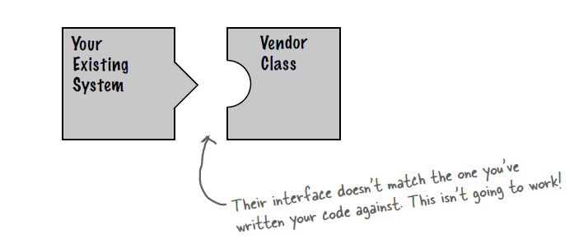
Adapter Pattern

Slide 7
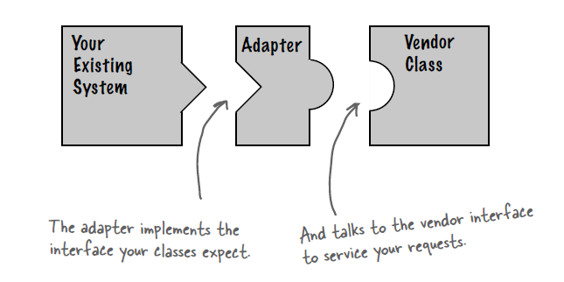
Adapter Pattern

Slide 8
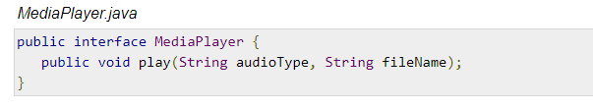
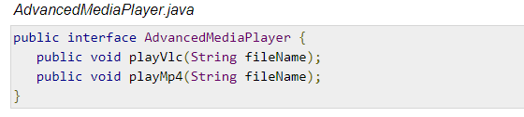
Adapter Pattern

Slide 9
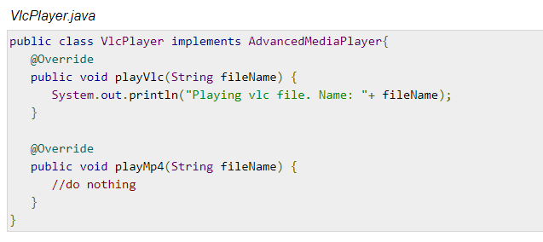
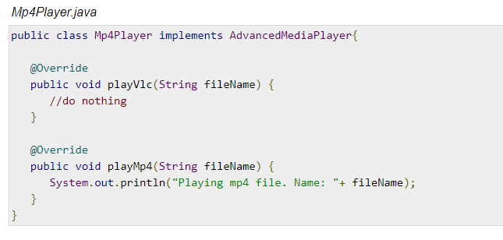
Adapter Pattern

Slide 10
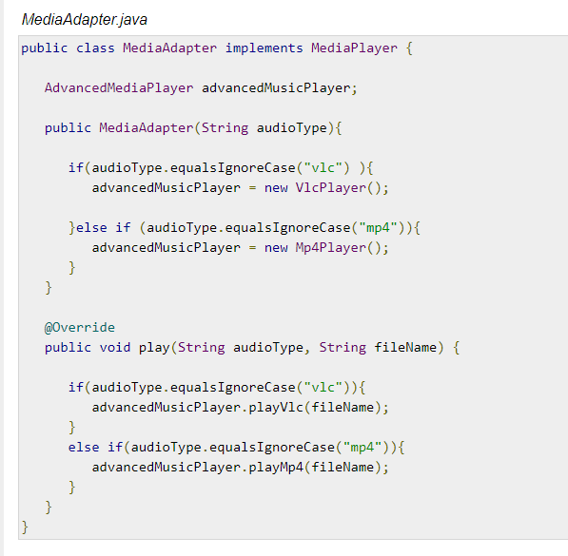
Adapter Pattern

Slide 11
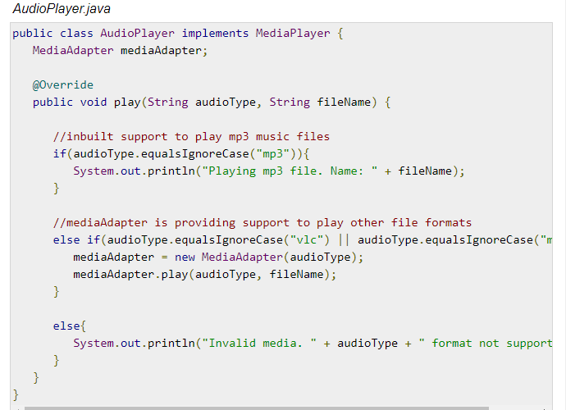
Adapter Pattern

Slide 12
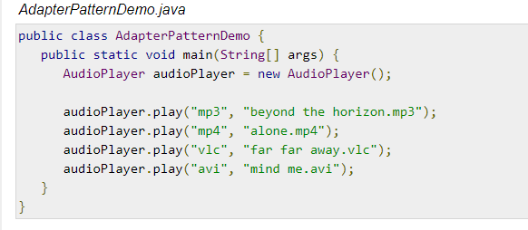
Adapter Pattern

Slide 13
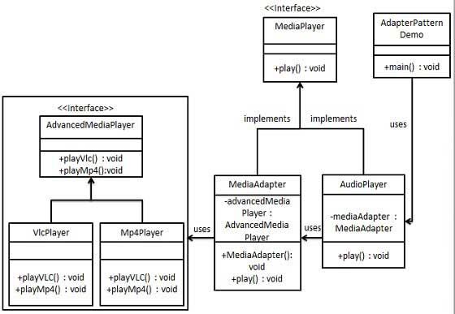
UML Diagram for Adapter Pattern

Slide 14
Decorator Pattern
Decorator pattern allows a user to add new functionality to an existing object without altering its structure.
This type of design pattern comes under structural pattern as this pattern acts as a wrapper to existing class.
This pattern creates a decorator class which wraps the original class and provides additional functionality keeping class methods signature intact.

Slide 15
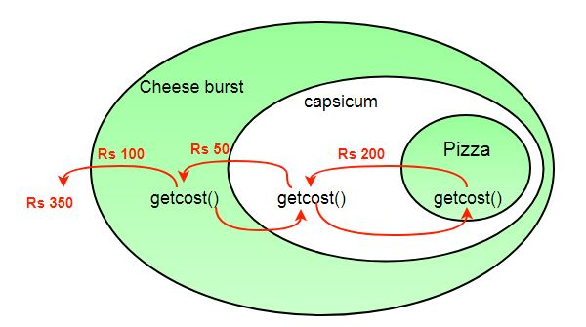
Decorator Pattern

Slide 16
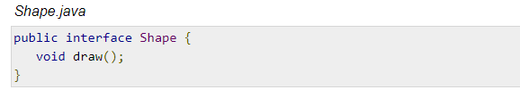
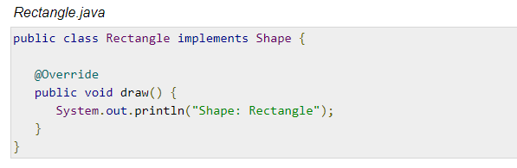
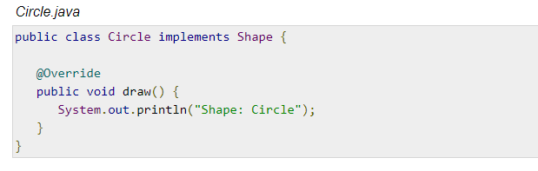
Decorator Pattern

Slide 17
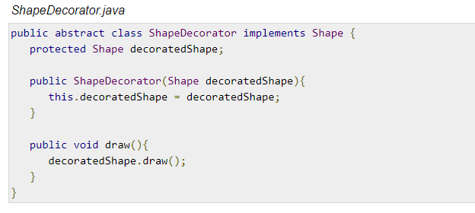
Decorator Pattern

Slide 18
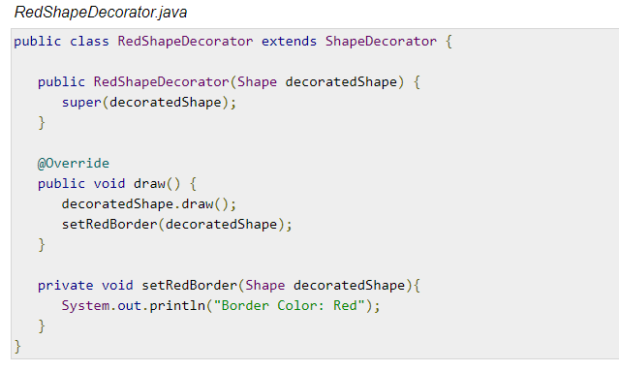
Decorator Pattern

Slide 19
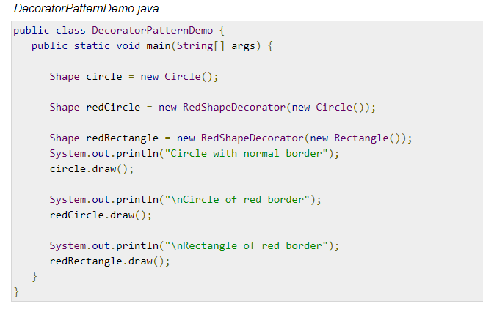
Decorator Pattern

Slide 20
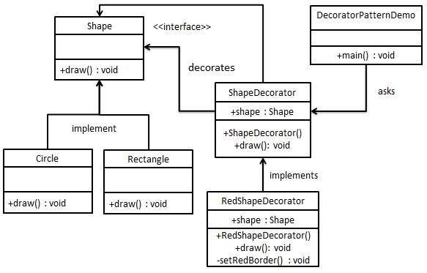
UML Diagram of Decorator Pattern

Slide 21
HW
Which Pattern is Similar to Decorator?

Slide 22
HW
Which Pattern is Similar to Decorator?
Ans: Strategy
Why decorator seems similar to each other?
What are the differences?
Are they (strategy and Decorator) can be used alternatively?

